Slide 1
Secure Messenger Design
Pranav Sudeendra and Arjun Seth

Slide 2
Setup
Architecture:
Server – Central Auth/ Discover Hub (No message relay)
Client – Ephemeral Keys, Peer-to-Peer Communication
Assumptions:
Server public key is pre-trusted by all clients
Clients have pre-registered and verifiers are stored in the server (If time permits, will implement the registration protocol)
Services:
Mutual Authentication – Server signed keys with Password authenticated Key Exchange​
Confidentiality and Non-repudiation – AES-GCM with ECDH keys​
Integrity – HMAC Sha-256 for messages​
PFS – Ephemeral ECDH keys​
DoS Resistance – Rate limiting and exponential backoff​

Slide 3
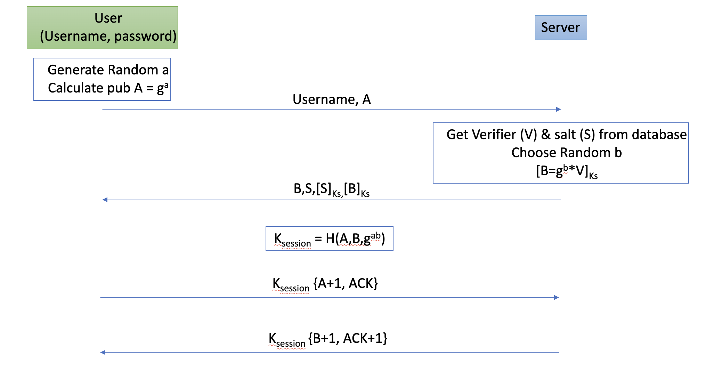
Authentication Protocol
Offline dictionary attack: The proposed system uses PAKE (Password Authenticated Key Exchange) to ensure password is not transmitted during authentication.
Server stored Only a cryptographic verifier V = Argon2id (salt, password)
Online dictionary attacks can be prevented by rate limiting and exponential back off (if time permits).
Assumption : Ks is private key of Server and every client has signed public key of server.

Slide 4
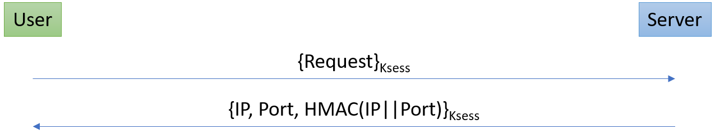
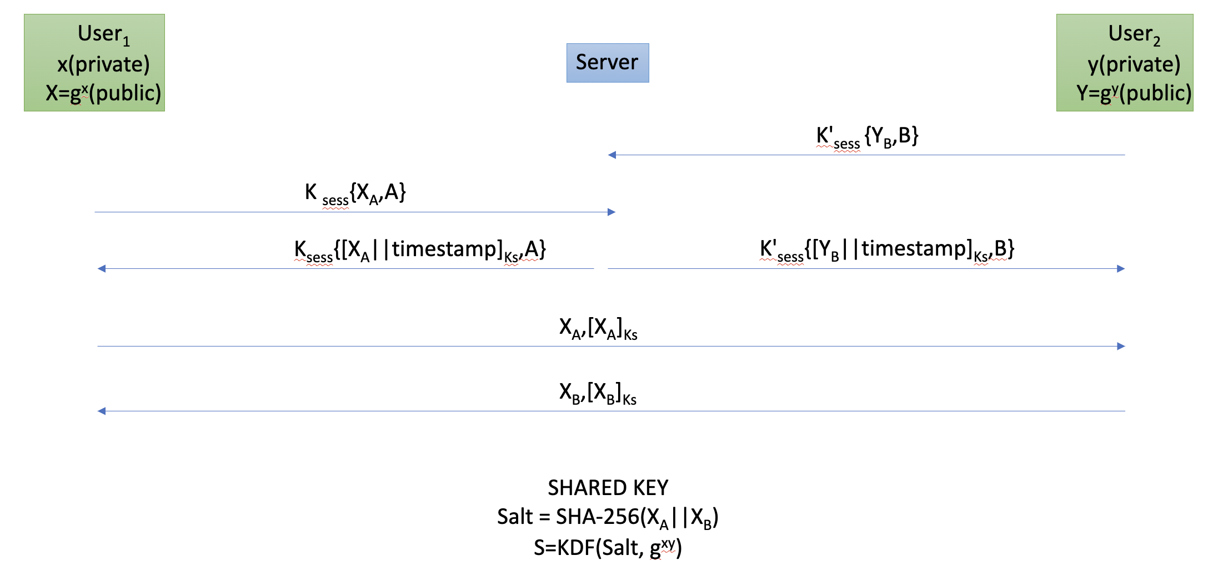
Key establishment and peer–to–peer communication
Peer Discovery
Assumptions:
Server authentication is trusted.
A and B are nonces, Each client generates an ephemeral Key pair (x, X) upon login with the server.
G is agreed upon previously.
Timestamp acts as nonce.
The keys are derived using authenticated ECDH.
ECDH is used. This gives authentication, confidentiality and non repudiation.
KDF is used to provide protection against weak passwords.

Slide 5
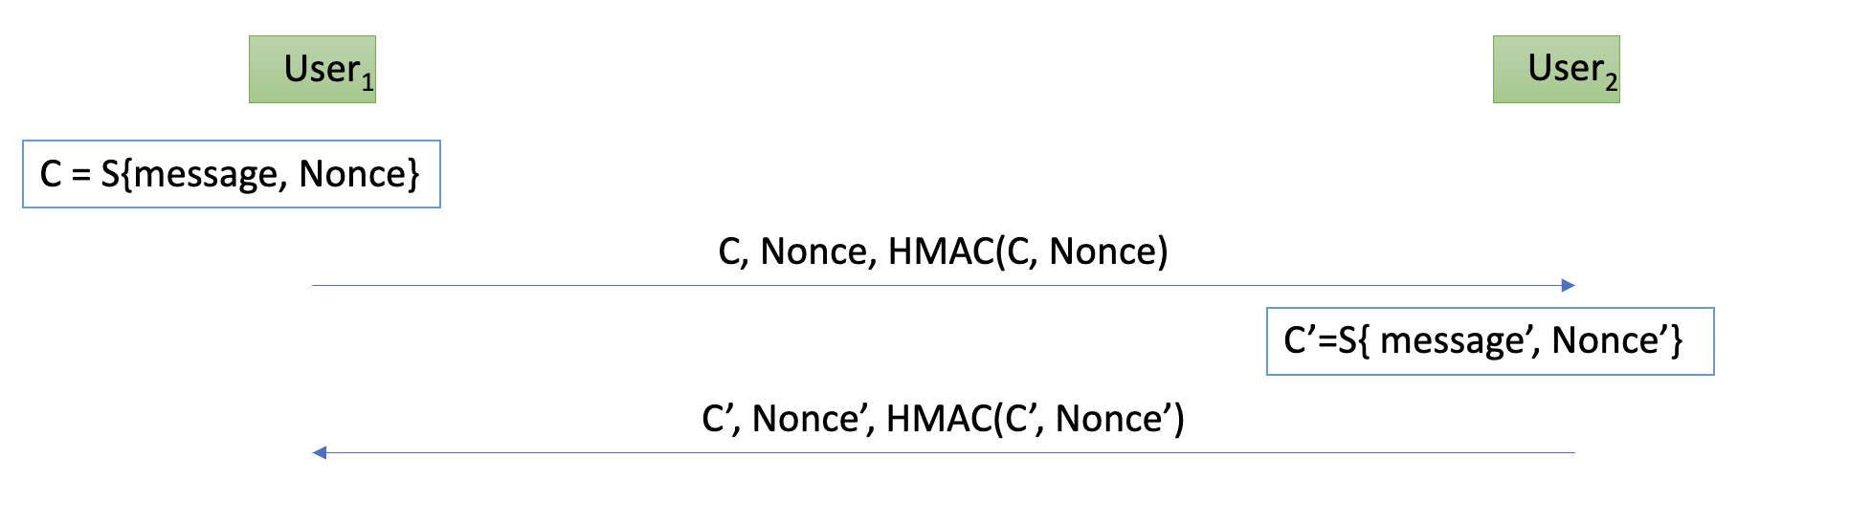
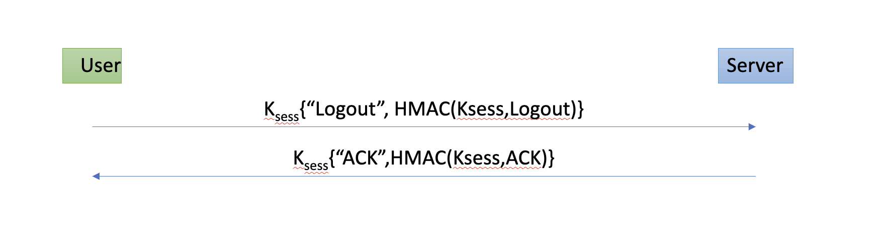
Messaging and logout protocol
PFS:
To ensure PFS all ephemeral keys established with other peers and the server have to be destroyed. This includes x,X,y,Y,a,A,b,B,Kses,SXa, Xb.

Slide 6
Feature | Implementation Details | Resilience Provided
Weak Password Protection | PAKE protocols (e.g., SRP), Argon2id hashing, rate limiting, exponential backoff | Prevents offline dictionary attacks; mitigates online brute-force attempts
DoS Resistance | Rate limiting (if time permits), proof-of-work challenges, stateless messaging | Reduces resource exhaustion risks; lightweight handling of malicious requests
Endpoint Hiding | Encrypt IP/port metadata using session key Ksession | Prevents correlation of user identities with network endpoints
Perfect Forward Secrecy (PFS) | Ephemeral ECDH keys discarded after use; KDF-derived encryption keys | Ensures past communications remain secure even if long-term secrets are compromised
Server Trust Minimization (Bonus) | Ephemeral key signing + SAS verification. | This implementation does not allow server to decrypt messages between clients. SAS verification could be used when the server is not trusted. This verification is through an out of band channel. This ensures secure communication when server is not trusted.

Slide 7
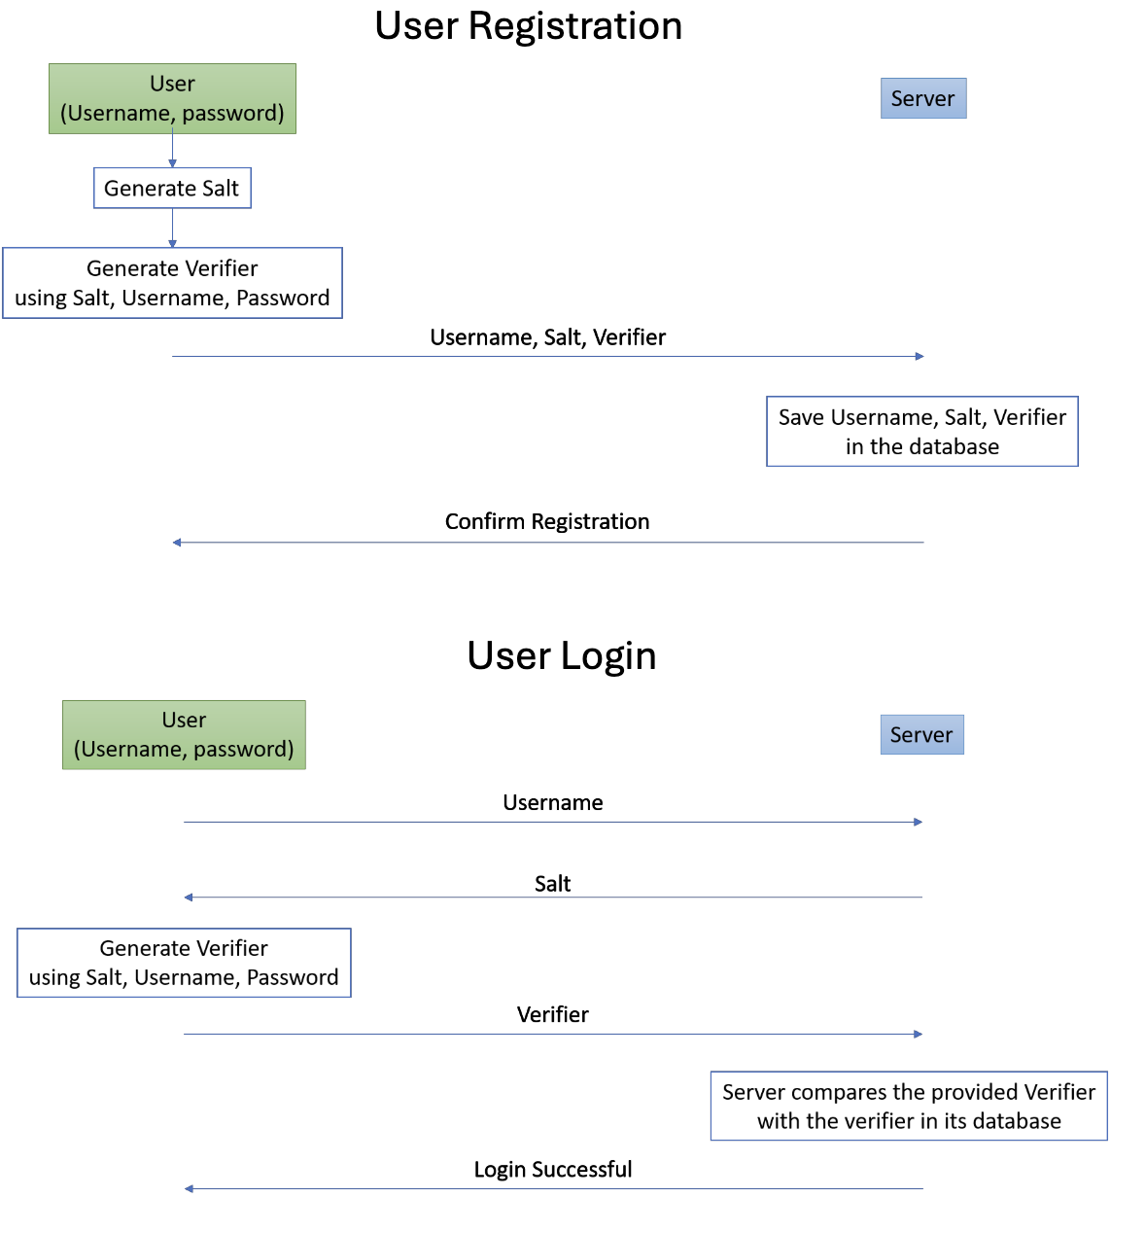
If Time Permits :

